Slide 1
Discussion today
Today we will cover a basic introduction to the Lumerical scripting language
We will revisit the ZnO nanowire as an example
Lumerical software shares a common scripting language that makes it possible to automate all aspects of simulation

Slide 2
Setup and analysis scripts
Setup scripts are used for setting up structures
Analysis scripts process data after simulation runs
Can also have standalone scripts that can do both

Slide 3
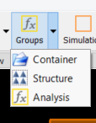
Groups
Groups are used to organize structures in a hierarchical fashion
Container groups hold objects but have no scripts
Structure groups have a Setup script
Analysis groups have both Setup and Analysis scripts
Useful if you have many structures (eg. array of objects) or complex structure with many components (eg. grating coupler)
Top-level model object is an Analysis group and contains both Setup and Analysis scripts

Slide 4
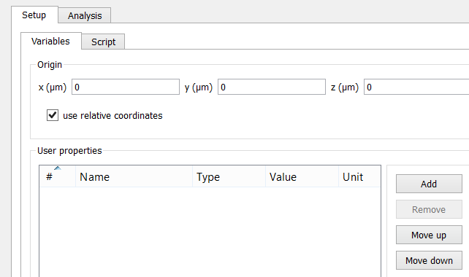
Setup and analysis scripts
Open disc12_ZnO_nanowire_laser_mirror.fsp
Right-click model object, Edit object
Setup script tab
Analysis script tab
Origin of group
Structures’ coordinates are
relative to this origin
Script variables
Can be lengths, materials, numbers, etc.

Slide 5
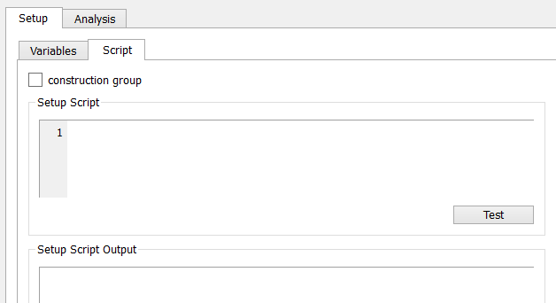
Setup script
Two length parameters are set for the total simulation dimensions
Click Script tab
If “construction group”, group is designed to create its structures instead of modifying them
deleteall; command will be added, which deletes all existing structures in group
Can test first to see errors below

Slide 6
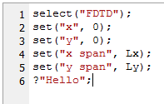
Setup script
Semicolons required
select selects an existing object
To refer to an object in a subgroup, use the notation “group::object”
Note that SI units are used regardless of simulation settings. Therefore this length is in meters
set sets a property of the object
Any property seen in the Edit menu can be set, including materials
For boolean values use true or false.
For materials use a string containing the name of the material
Use “?” to print things: useful for debugging

Slide 7
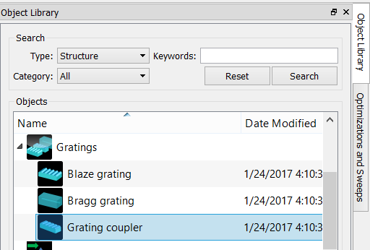
Example: grating coupler structure group
Double click Grating coupler from Object Library to create
This is what we used in past simulations
Expand object in tree, you will see many polygons called post and coating comprising the grating coupler
Setup script contains many examples of script syntax: if statements, for loops, matrices, creating objects, etc.

Slide 8
Optimizations
Lumerical FDTD has built-in feature to optimize a figure of merit using Particle Swarm optimization
Optimizer randomly generates n simulations (“particles”), n = generation size
Each particle moves towards best result to produce next generation
Usually converges after <5 generations (depends on complexity)
Can only optimize a scalar (not array or matrix), so usually need Analysis script to extract a single element of array

Slide 9
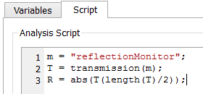
Analysis script
Delete grating coupler object
Right-click model, Edit, go to Analysis tab
Result called R has been added
These results are set in script and will show up in result list of parameter sweeps and optimizations
Go to Script tab:
Monitor name
The transmission function gets transmission normalized to source power, as an array for all frequencies
Get the middle element (=middle frequency)

Slide 10
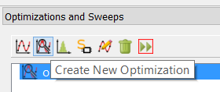
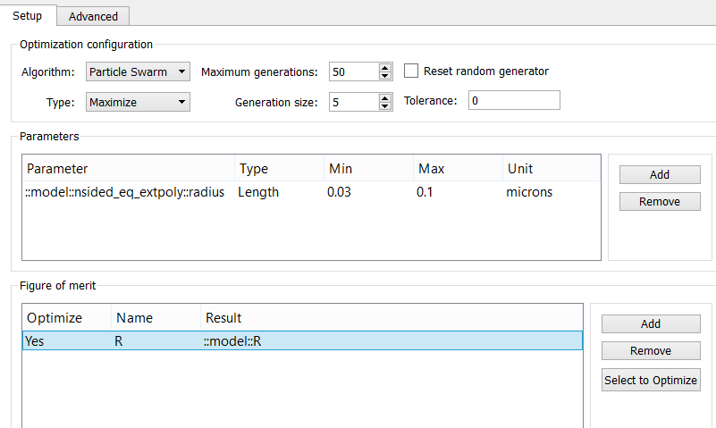
Optimization
Create new optimization
Right-click, Edit
Optimize nanowire radius
Maximize reflection

Slide 11
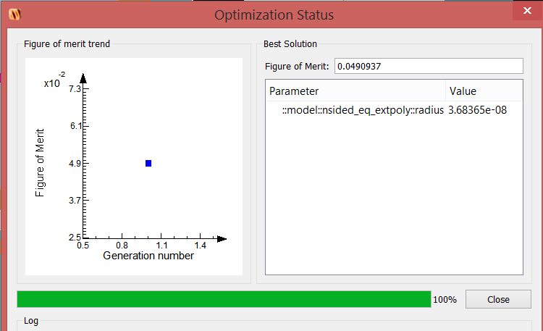
Optimization
Click Run button to start optimization (same button as for sweep)
Optimized reflectance after 1 generation is 5%, much better than initial 0.7% (your results may vary)
Radius is 37 nm (original 65 nm)
Diameters varied from 20 to 150 nm in the paper

Slide 13
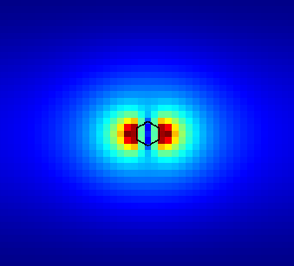
Reflectivity is higher, but mode confinement is much weaker due to smaller wire

Slide 14
Optimization
For single variable such as this, sweep is probably better
In this case we would also like to optimize reflection from air interface, and confinement factor

Slide 15
Other resources
Scripting language reference: https://kb.lumerical.com/en/index.html?ref_scripts_scripting_language.html
Example simulations: https://kb.lumerical.com/en/applications.html

